Slide 1






ELECTRIC VEHICLES ANALYSIS
For AtliQ Motors
Presented By Yogesh Kurane

Slide 2





Agenda
About AtliQ Motors
Problem Statement
Goal
Dataset, Requests and Tools
Preliminary Research Questions
Secondary Research Questions
Dashboard Showcase
Presented By Yogesh Kurane

Slide 3
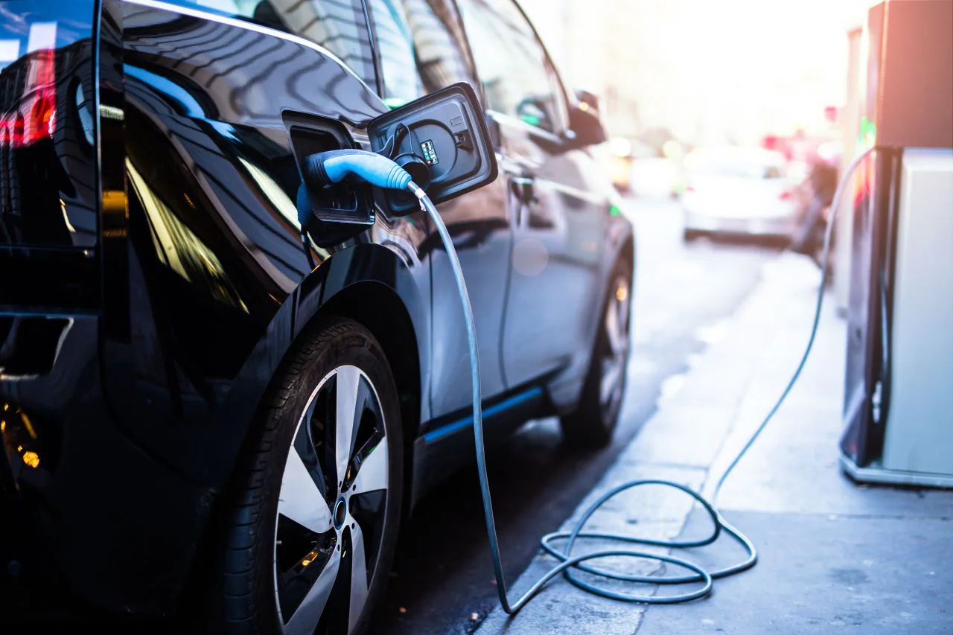
About AtliQ Motors
USA-based EV Leader – Specializes in electric and hybrid vehicles.
Strong Market Presence – Achieved 25% market share in North America over the last 5 years.
Eco Friendly Focus – Committed to reliable and sustainable mobility.
Global Expansion Plans – Aims to grow internationally with a customer-centric approach.
Presented By Yogesh Kurane

Slide 4

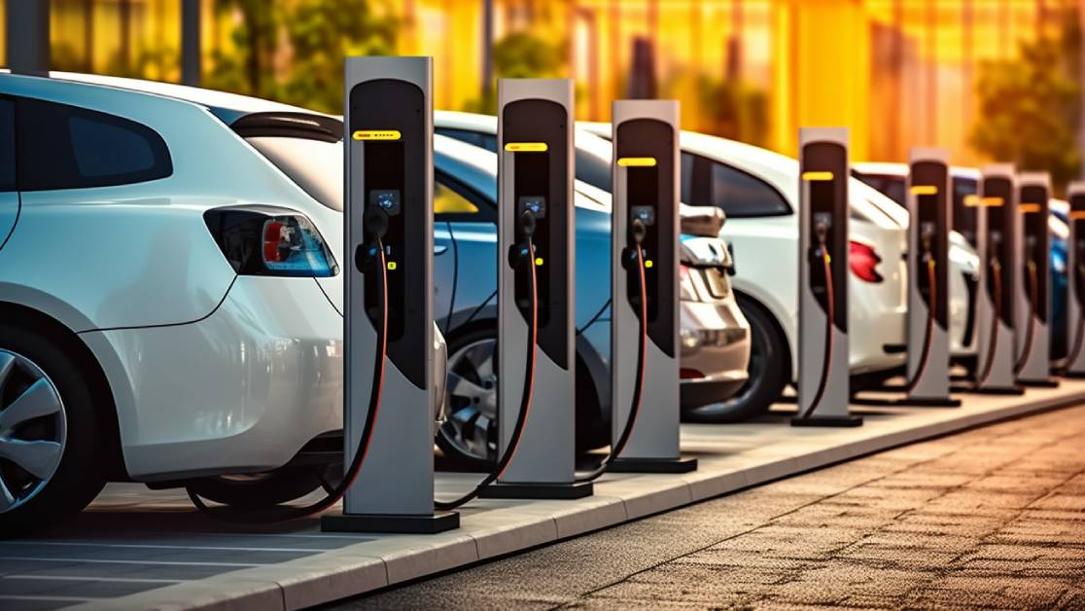

Problem Statement
Low Market Share & Brand Awareness – With less than 2% market share, the company struggles to gain visibility and compete in India’s EV/Hybrid market.
Challenges in Market Expansion – Reaching customers and building a strong distribution network remain major hurdles.
Lack of a Structured Business Plan – Without a clear market entry strategy, growth and brand positioning could be slow and ineffective.
Presented By Yogesh Kurane

Slide 5



Goal
Data Analysis & Insights – Analyze the available dataset to extract meaningful insights and trends.
Impactful Metrics & Visuals – Create clear and effective metrics and visualizations for Mr. Bruce Haryali, Chief of AtliQ Motors India.
Data-Driven Decision Making– Provide actionable recommendations based on data to support expansion strategies and long-term growth plans.
Presented By Yogesh Kurane

Slide 6


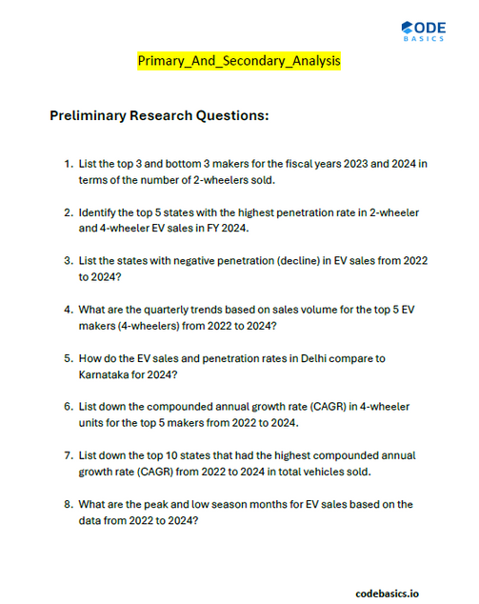
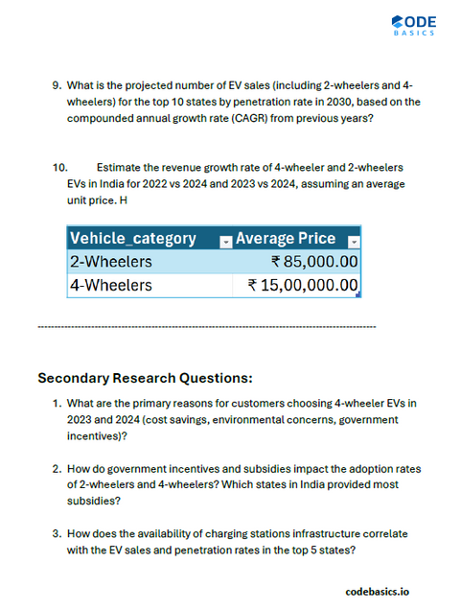

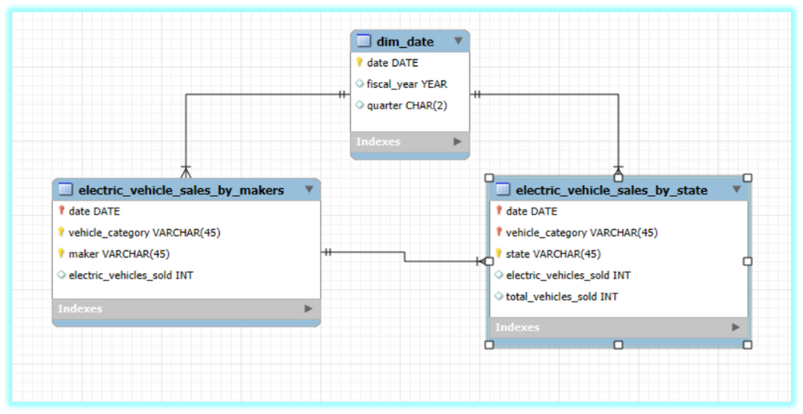
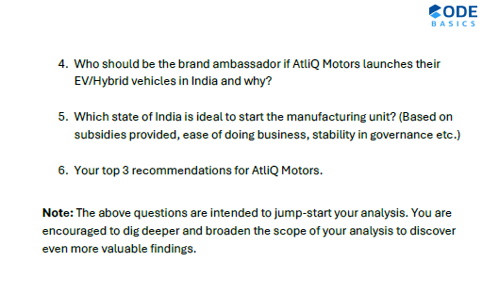
Dataset, Requests and Tools
For Data analysis and Visualization
For Ad Hoc Queries
Dataset / Model
Ad Hoc Requests
Presented By Yogesh Kurane

Slide 7
Preliminary Research Questions
Presented By Yogesh Kurane

Slide 8
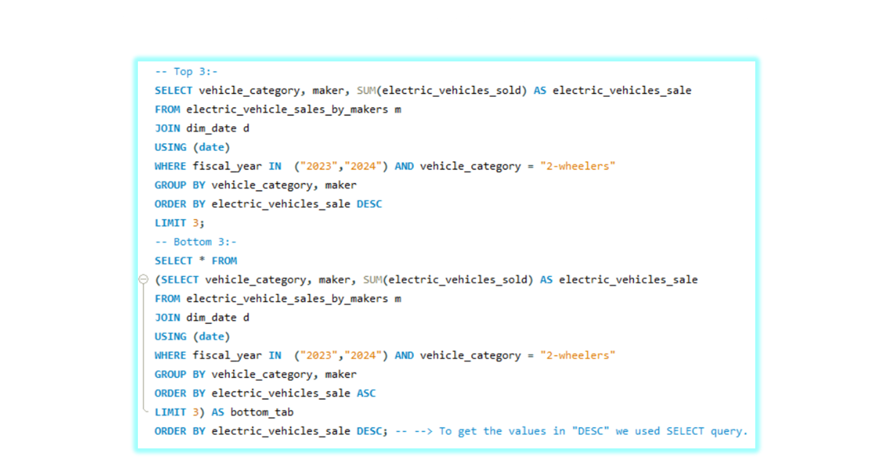
1. List the top 3 and bottom 3 makers for the fiscal years 2023 and 2024 in terms of the number of 2-Wheelers sold.
Presented By Yogesh Kurane

Slide 9
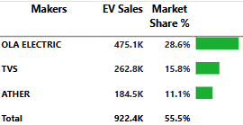
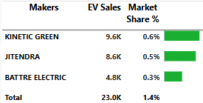
Top 3 Makers for Fiscal years 2023 and 2024
Bottom 3 Makers for Fiscal years 2023 and 2024
Here the highest sale in case of top 3 makers is of OLA ELECTRIC with 4.75 Lakh
Here the highest sale in case of bottom 3 makers is of KINETIC GREEN with 9.5 K
Presented By Yogesh Kurane

Slide 10
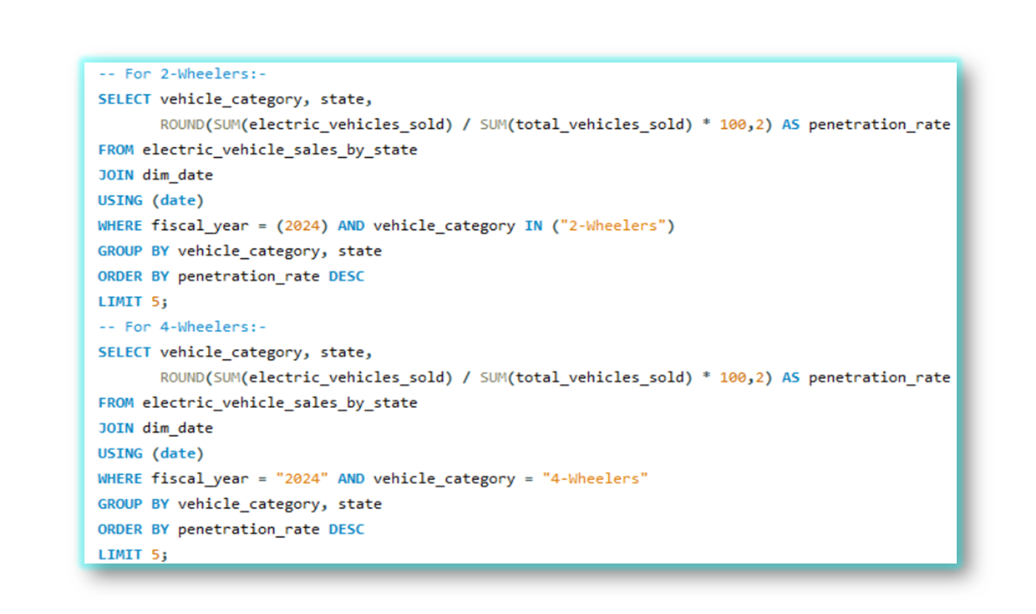
2. Identify the top 5 states with the highest penetration rate in 2-wheeler and 4-wheeler EV sales in FY 2024.
Presented By Yogesh Kurane

Slide 11
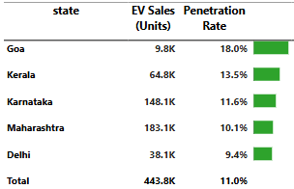
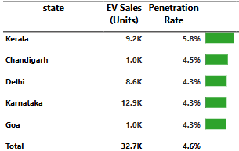
2 - Wheelers
4 - Wheelers
In 2-Wheelers the highest penetration rate is of state Goa with 18% and lowest Delhi with 9.4%
In 4-Wheelers the highest penetration rate is of state Kerala with 5.8% and lowest Goa with 4.3%
Presented By Yogesh Kurane

Slide 12
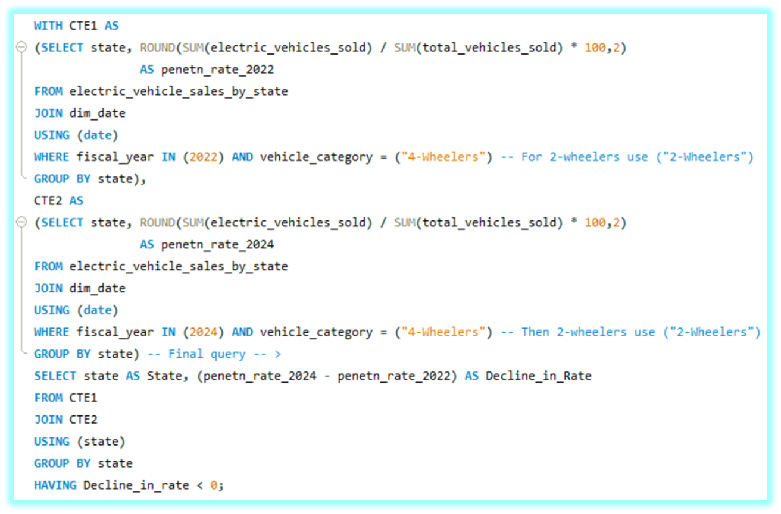
3. List the states with negative penetration (decline) in EV sales from 2022 to 2024?
Presented By Yogesh Kurane

Slide 13
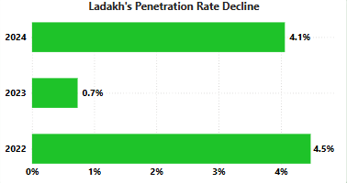
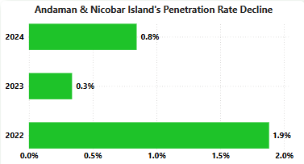
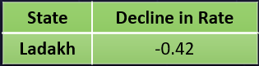
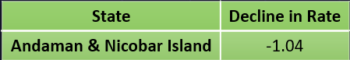
2 - Wheelers
4 - Wheelers
The penetration Rate in state Ladakh has declined to -0.42% from 2022 to 2024.
The rate was 4.5% in the year 2022 and got a decline and reached 4.1% in 2024.
The penetration Rate in state Andaman & Nicobar Island has declined to -1.04% from 2022 to 2024.
The rate was 1.9% in the year 2022 and got a decline and reached 0.8% in 2024.
Presented By Yogesh Kurane

Slide 14
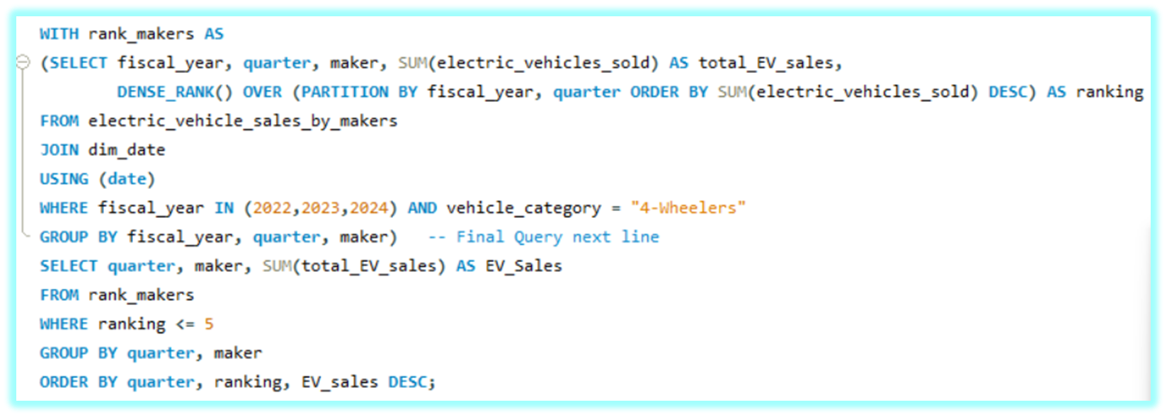
4. What are the quarterly trends based on sales volume for the top 5 EV makers (4-wheelers) from 2022 to 2024
Presented By Yogesh Kurane

Slide 15
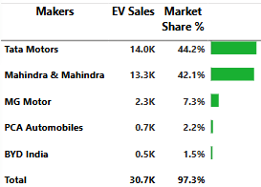
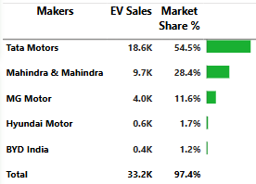
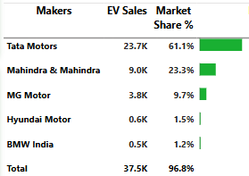
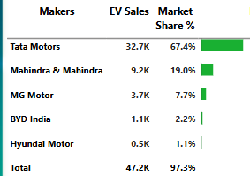
Q1
Q2
Q3
Q4
Tata Motors is leading in this case. Then on 2nd place Mahindra & Mahindra and 3rd MG Motor. There is a slight change in sales every qurater for all 4-Wheelers.
Presented By Yogesh Kurane

Slide 16
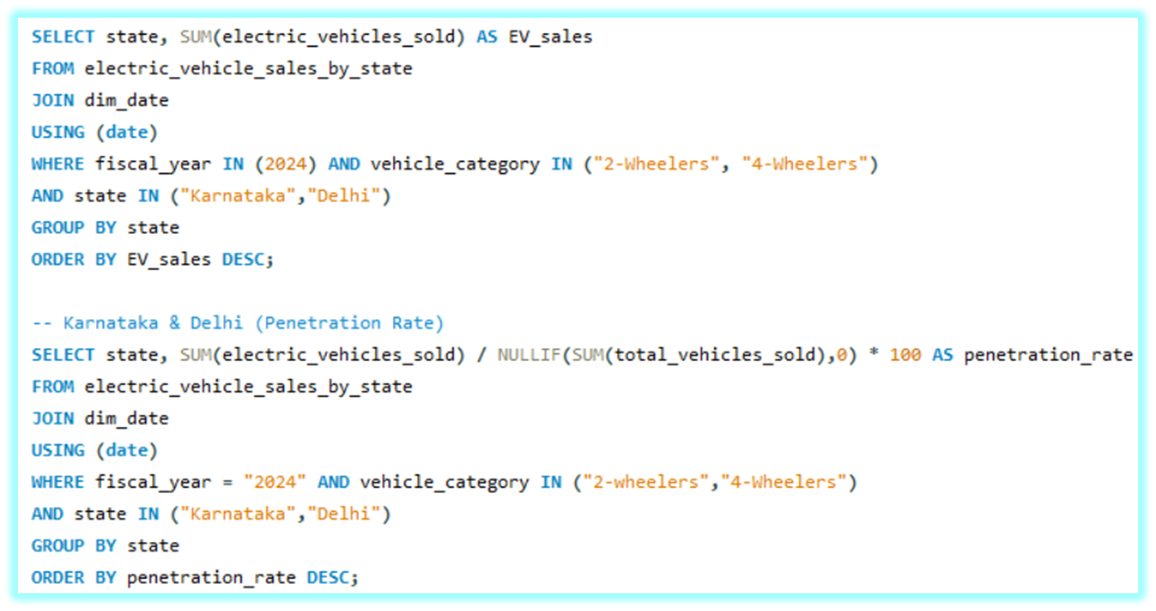
5. How do the EV sales and penetration rates in Delhi compare to Karnataka for 2024?
Presented By Yogesh Kurane

Slide 17
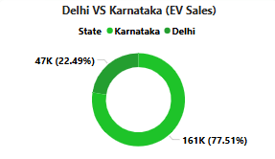
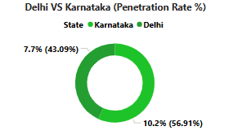
Here Karnataka has 160.0K Units sold with 10.2 % Penetration Rate and Delhi with 46.7K Units sold and 7.7% Penetration Rate
Presented By Yogesh Kurane

Slide 18
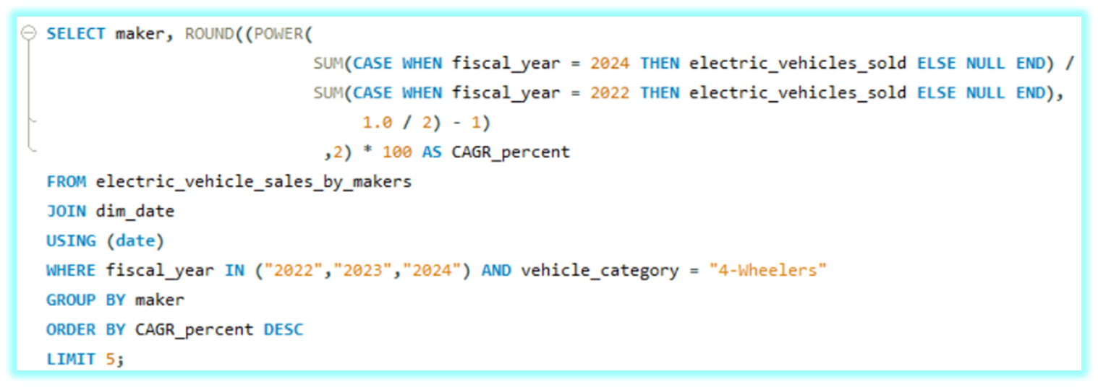
6. List down the compounded annual growth rate (CAGR) in 4-wheeler units for the top 5 makers from 2022 to 2024.
Presented By Yogesh Kurane

Slide 19
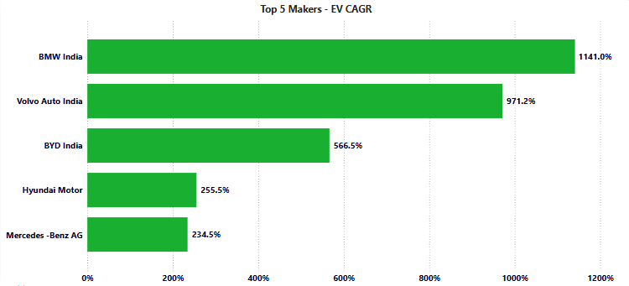
Here BMW India has the highest CAGR with 1141.0% and Volvo Auto India with 971.2%
Presented By Yogesh Kurane

Slide 20
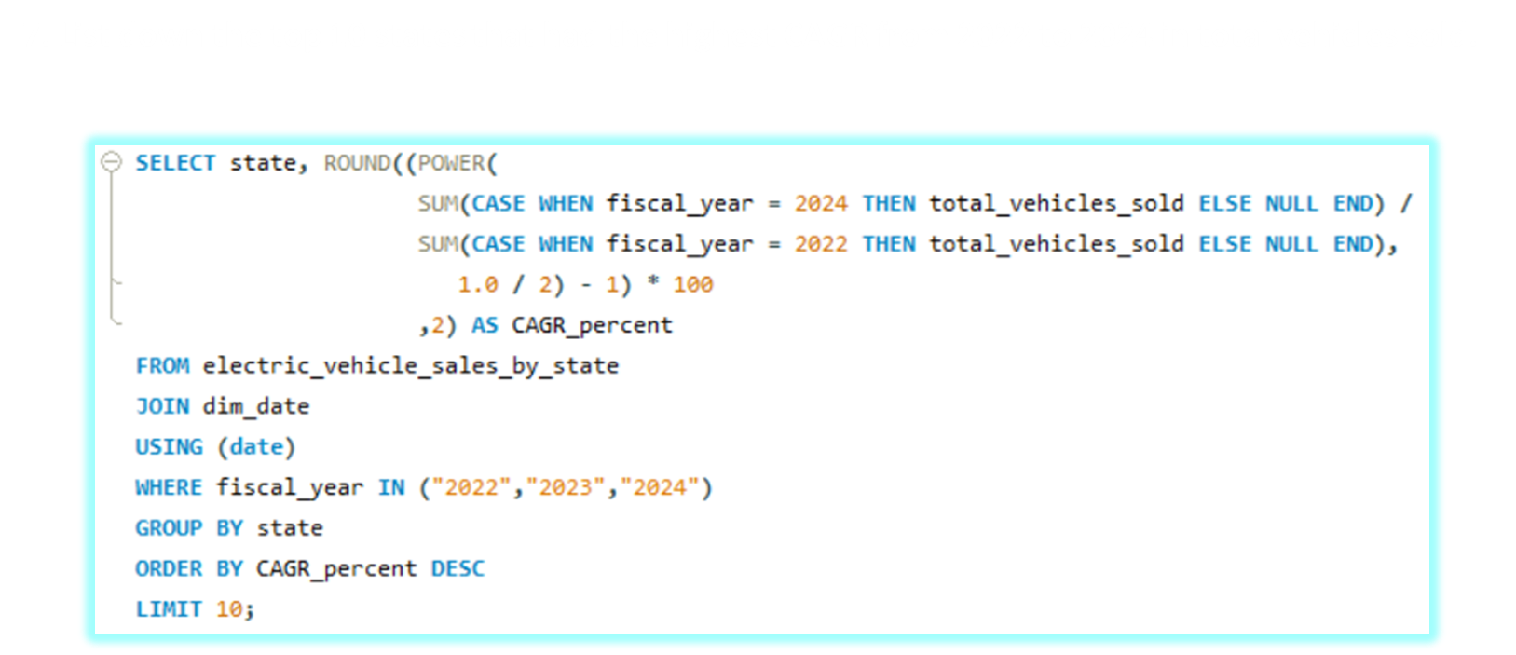
7. List down the top 10 states that had the highest CAGR from 2022 to 2024 in total vehicles sold.
Presented By Yogesh Kurane

Slide 21
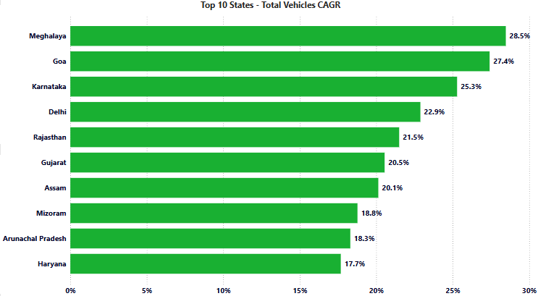
Here the highest CAGR performing state is Meghalaya with 28.5%, 2nd Goa with 27.4%, 3rd Karnataka with 25.3%.
Presented By Yogesh Kurane

Slide 22
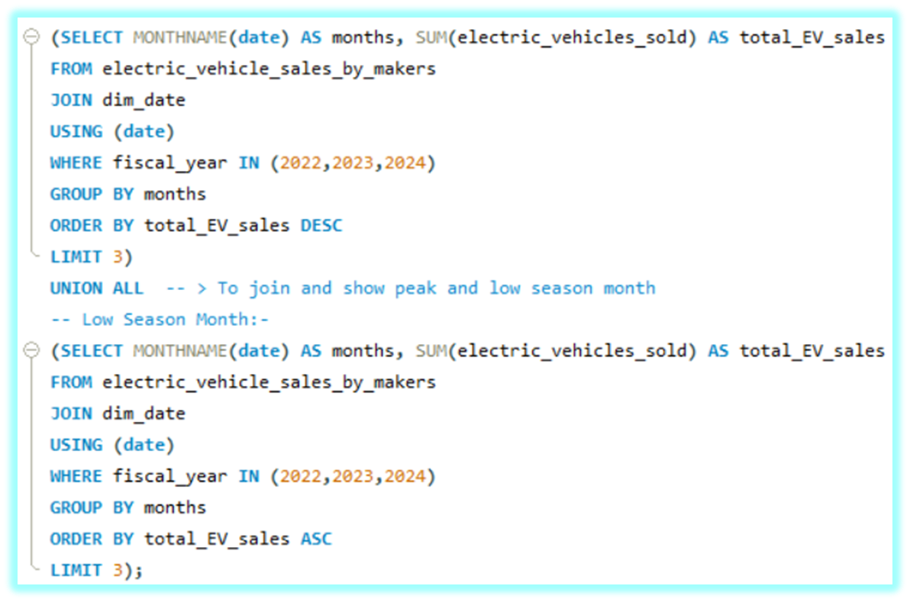
8. What are the peak and low season months for EV sales based on the data from 2022 to 2024
Presented By Yogesh Kurane

Slide 23
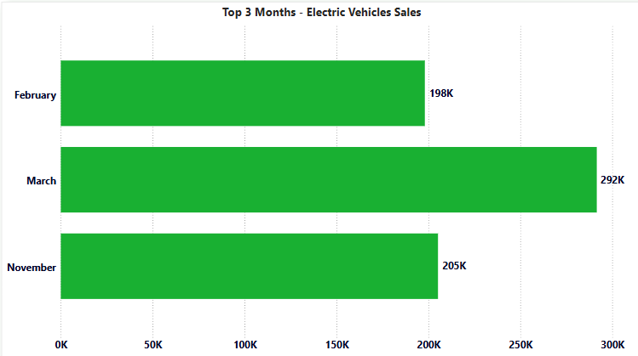
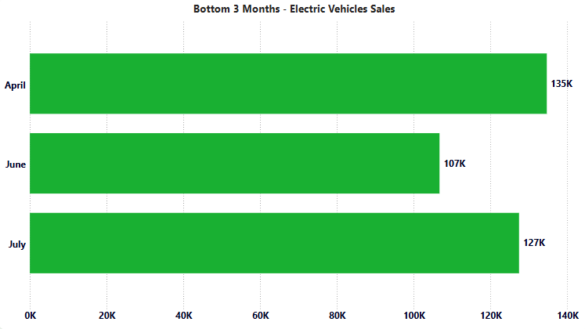
Here the Top 3 Peak Season Months are February, March, November.
Here the Bottom 3 Season Months are April, June, July.
Presented By Yogesh Kurane

Slide 24
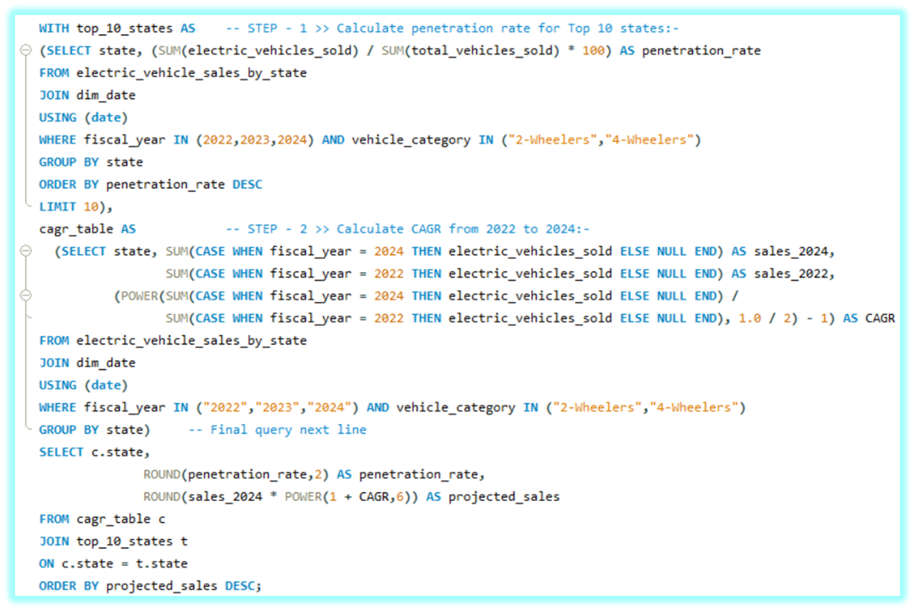
9. What is the projected number of EV sales (including 2-wheelers and 4-wheelers) for the top 10 states by penetration rate in 2030, based on the compounded annual growth rate (CAGR) from previous years?
Presented By Yogesh Kurane

Slide 25
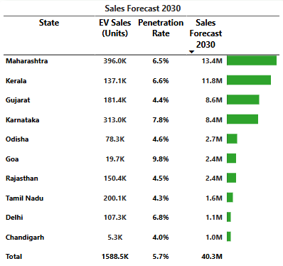
Here the state with the highest forecasted sales is Maharashtra with 13.35M units.
Chandigarh is the state with lowest forecasted sales of almost 1.0M units.
Kerala has the second highest sales with 11.8M units.
Goa has less EV sales currently compared to top sates but still has good forecasted sales.
Presented By Yogesh Kurane

Slide 26
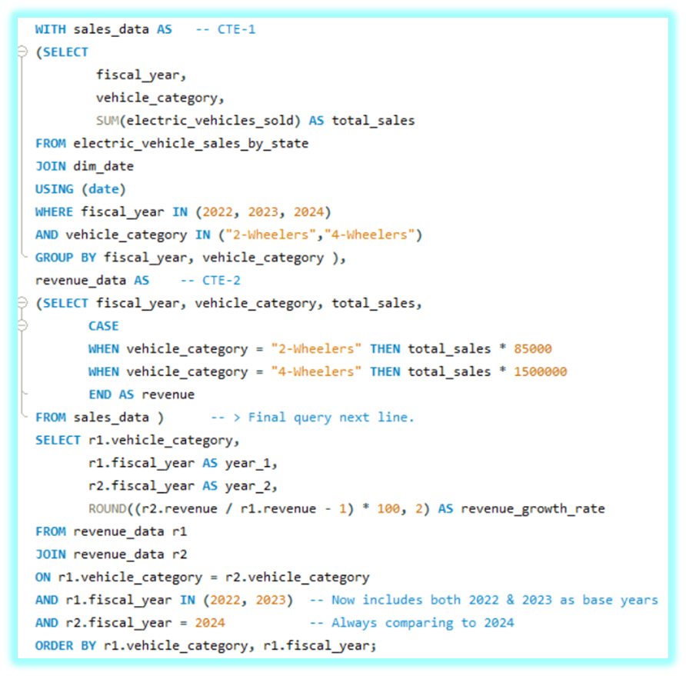
10. Estimate the revenue growth rate of 4-wheeler and 2-wheeler EVs in India for 2022 vs 2024 and 2023 vs 2024, assuming an average unit price - ₹85,000 (2-wheelers) and ₹ 15,00,000 (4-wheelers)
Presented By Yogesh Kurane

Slide 27
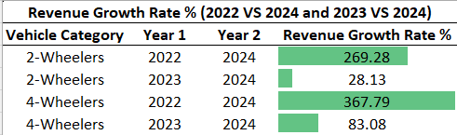
Here the highest growth rate in 2-Wheelers segment is 269.28% and in 4-Wheelers segment it is 367.79%. This is 2022 vs 2024 analysis.
The rate are 28.13% for 2-Wheelers and 83.03% for 4-Wheelers segment. This is 2023 vs 2024 analysis.
Presented By Yogesh Kurane

Slide 28
Secondary Research Questions
Presented By Yogesh Kurane

Slide 29
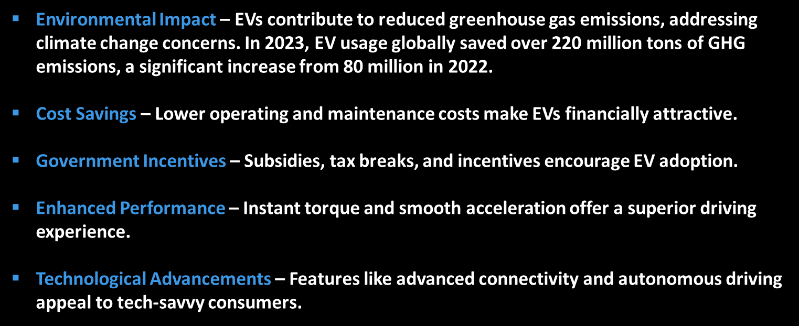
1.What are the primary reasons for customers choosing 4-wheeler EV in 2023 and 2024?
Presented By Yogesh Kurane

Slide 30
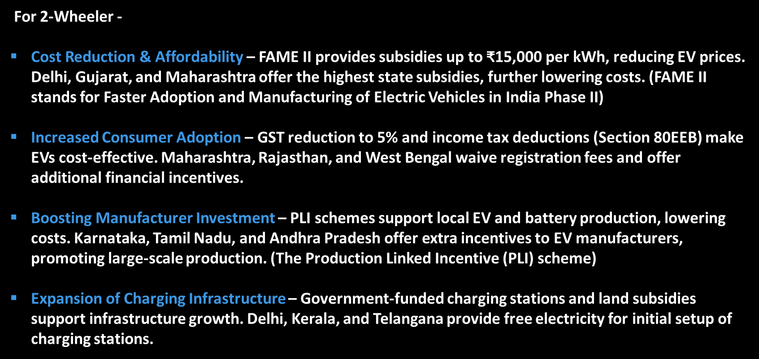
2. How do government incentives and subsidies impact the adoption rates of 2-wheelers and 4-wheelers? Which states in India provided most subsidies?
Presented By Yogesh Kurane

Slide 31
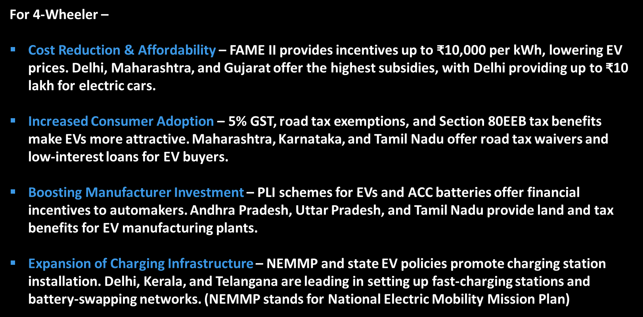
Presented By Yogesh Kurane

Slide 32
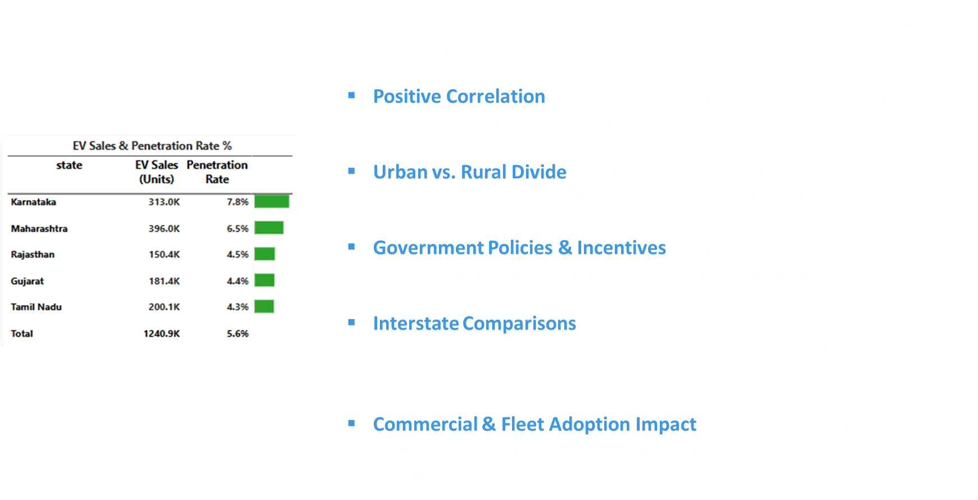
3. How does the availability of charging stations infrastructure correlate with the EV sales and penetration rates in the top 5 states?
Presented By Yogesh Kurane

Slide 33
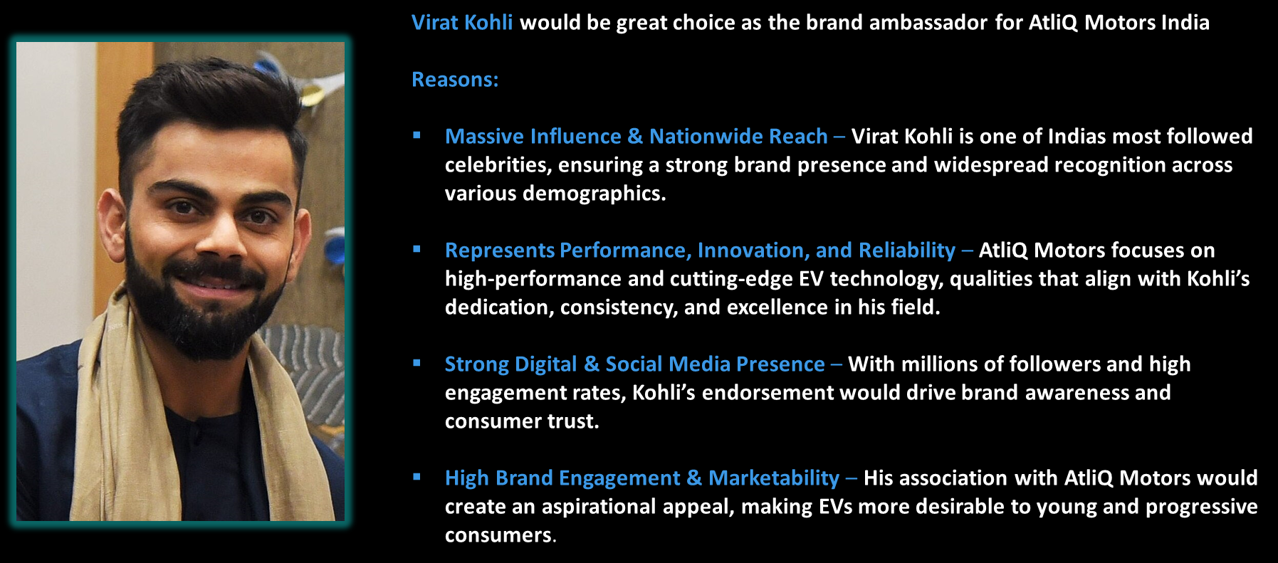
4. Who should be the brand ambassador if AtliQ Motors launches their EV/Hybrid vehicles in India and why?
Presented By Yogesh Kurane

Slide 34

5. Which state in India is ideal to start the manufacturing unit? (Based on subsidies provided, ease of doing business, stability in governance etc.)
Presented By Yogesh Kurane

Slide 35

6. Your top 3 recommendations for AtliQ Motors
Presented By Yogesh Kurane

Slide 36
Let’s explore the dashboard
Presented By Yogesh Kurane

Slide 37
Conclusion
This analysis helps in understanding the overall scenario of the Indian EV/Hybrid models’ segment. The penetration rate and CAGR calculations have shown that few states in India have high growth potential in EVs and related vehicles segment. The significance of incentives and subsidies also matter a lot. Following points can help AtliQ Motors in their business path:
Identify top states with highest demand for EV vehicles and incentives that benefit customers the most.
Use different marketing strategies to differentiate products from competitors.
Focus on reliability and price the products low to medium.
Always aim for long-term growth and try hard to retain customers by providing top class after sales service.
Presented By Yogesh Kurane

Slide 38
Thank You
Presented By Yogesh Kurane

